Slide 1
Instagram Tag and Caption generator
Arpita Ambavane . Anuhya Mandalapu .
Sai Akhil Teja . Neerab Kumar Pathipaka .

Slide 2




motivation
What caption or Tag should I add?
That’s so cool
How can I get more followers?
How do I get more Insta likes?
Instagram
Tag & Caption
Recommender

Slide 3
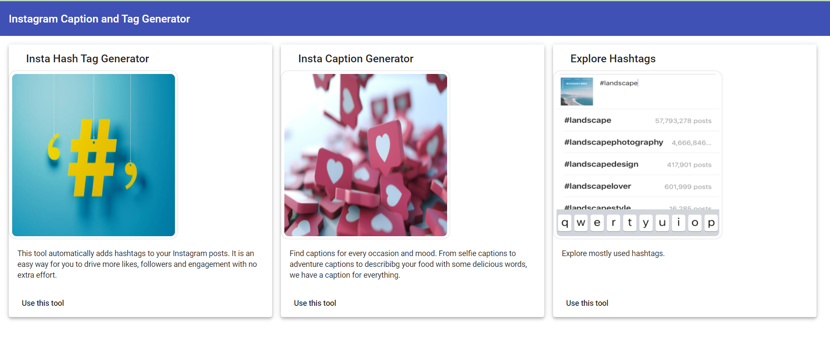
Demo
We ran out of GCP credits and hence posting the demo link.
Demo Link : https://drive.google.com/file/d/19pTBrXu2K6TP2GDItgyO4IxzpqdQqmIz/view?usp=sharing

Slide 4
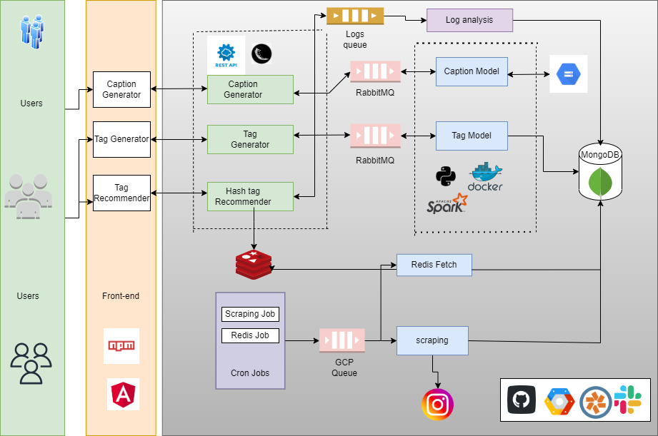
Architecture

Slide 5
Tech Stack :
Front End :
Angular, NPM.
Back End :
Flask, REST API’S, RabbitMQ, GCP Queue, MongoDB, Redis.
Deployment :
GCP, Docker.
Project Management tools:
GitHub, Slack, Pivotal Tracker

Slide 6
Component - Tag RecommendATION
Neural Networks, Base pretrained model MobileNetV2
ALS Model for recommendation of tags.
13 categories: #travel, #food, #animals, #cars, #babies, #wedding, #architecture, #selfie, #fitness, #nature, #shopping , #friends, #fashion.
Scraped 200 Images for each hashtag – aprox 3K Images

Slide 7
Component - Caption RecommendATION
Using dataset - Generic captions but not related to Instagram Model Captions.
Dataset consists of 80k images with atleast 5 captions each.
Using pre-trained model inceptionV3 to classify the images.
Caching the features in GCP bucket and utilizing it.
Model is Unable to generate the instagram language captions.

Slide 8

Component - Trending hashtags
Trending HashTags of 13 Categories are available for user
Top 10 HashTags are fetched from the recent scraped data from Insta API for each hashtag and put into redis cache.

Slide 9



Component - SCRAPING SCHEDULER
CRON scheduler is scheduled a time each day
Used GCP Schedulers and GCP Tasks to handle the requests.
Cronjob scrapes data from Insta API and updates the MongoDB accordingly.
Cronjob to store the data from MongoDb to redis

Slide 10
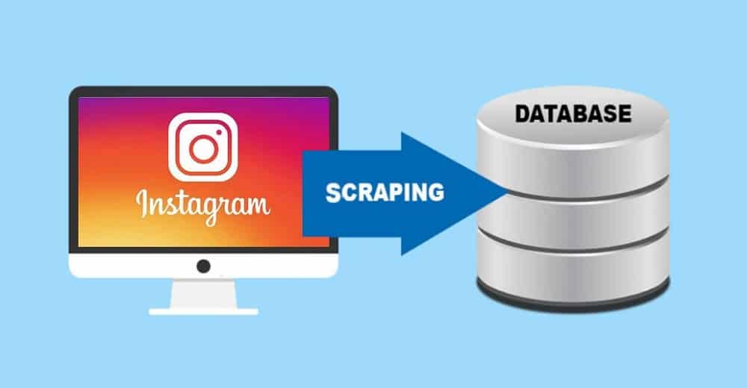


Retro - Challenges
Tag Model : Scraping - Time consuming, Account gets lock
Failed scraping hashtags from the Insta API
Caption Model : Not Instagram oriented Captions
Deploying ML Models on VMs : Running them on GCP was costly

Slide 11
Retro - Future improvements
Distributed Logging using Kibana, Elastic Search
Improve Caption generator Model
Increase scraping scheduler frequency of Instagram API for Tags at least two times a day

Slide 12

questions?

